Slide 1



a00s3e3 - DONE
F= -1.77969
F = -1.77893
F= -1.77588, unstable

Slide 2










a00s5e3
F = -2.986
F = -2.98574
F = -2.98732
F = -2.98580
F = -2.98637
F = -2.98644

Slide 3


a00s7e3 - DONE
F = -4.20090
F = -4.20224
Terran tried stripe (15.2, 20.2) & (12.2, 20.2). Unstable

Slide 4
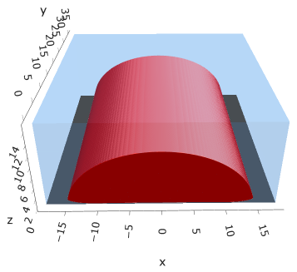
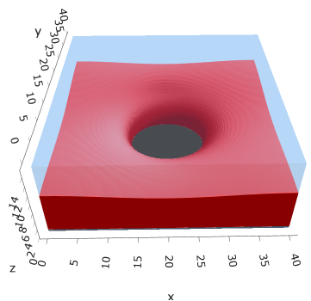
a05s5e3
F = -2.97413
F = -2.97364

Slide 5



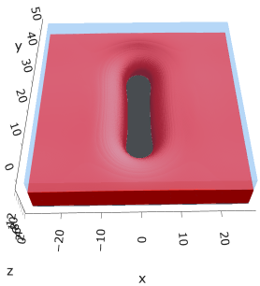

a10s5e3 - DONE
F = -2.93788
F = -2.93873
F = -2.93788

Slide 6
a20s015

Slide 7

a20s022
F = -12.3419

Slide 8
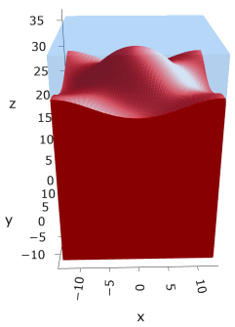
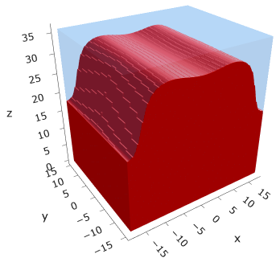

a20s025
F = -14.0022
F = -13.9965
F = -13.9755

Slide 9
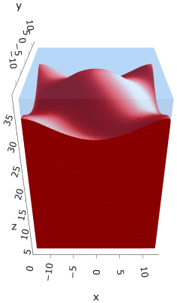


a20s027
F = -15.1086
F = -15.0898
F = -15.1050
Note: 2C isomin = 0.50

Slide 10
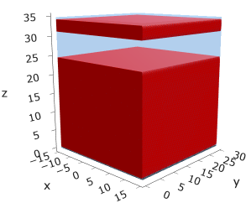
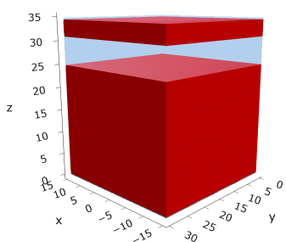
a25
s15
s18

Slide 11





a35
s10
s12
s15
s18

Slide 12



Parallelization
$$α=0, χ=1.25, N=50, σ=0.02$$
$$α=0, χ=1.25, N=200, σ=0.005$$
$$L_{x}=L_{y}=23, { L}_{z}=15$$
Nth = 12: 500 it, 4.3 hrs
Nth = 8 : 500 it, 6.9 hrs
Nth = 6 : 415 it, 20 hrs (poss. mem bottleneck)

Slide 13







Exercise: Micelle / Stripe
s = 5e-03, N = 50, a = 0.0, x = 1.0
s = 5e-03, N = 75, a = 0.0, x = 1.0
Isosurface at pha = 0.1

Slide 14






a040x170s020

Slide 15






a040x170s010

Slide 16

a040x170s025

Slide 17














a040x170s022

Slide 18










a040x170 seed
See if becomes hex
cyl4-975
cyl4-12
cyl16-975
cyl16-1025
cyl1

Slide 19






a040x170s017

Slide 20












































a040x170s015 seed
Almost done
Almost done

Slide 21

















a040x170s013

Slide 22
















a040x170s010 seed

Slide 23














X200 x170 x130 x120 x100
F = −10.24458
F = − 9.14301
F = −11.0057
F = −10.2429
F = −11.0015
F = −9.63949
F = −10.2461
F = −10.9948
F = − 9.63030
F = −10.2431
F = −10.9953

Slide 24





a040x100 relaxation

Slide 25








































a040x100 seed
old
old

Slide 26


a040x120 relaxation
F = −10.24458

Slide 27





































a040x120 seed
cyl16-850
cyl16-825

Slide 28






a040x130 relaxation

Slide 29




a040x170 relaxation
F = −9.10347
1 neck

Slide 30







a040x200 relaxation

Slide 31










a040x200 seed
Note: not completely converged but stopped for resources

Slide 33


a0.40 x1.70

Slide 34





Zhulina JCP 1998
a = 0.01
0.1 mM
1 mM
May need to init using sine
10 mM
25 mM
Zhulina NVT; current GCE runs at Lz = 20

Slide 35

Carrillo Langmuir 2009

Slide 36

Parallelization

Slide 37
Equations
Quenched average, np, A --> \inf ; np/A → \sigma
Discrete Gaussian chain

Slide 38




Scaling (Alexander—de Gennes brush)
V = 4.2; H = 27.5 – 30.5
V = 2; H = 39 – 45.5

Slide 39






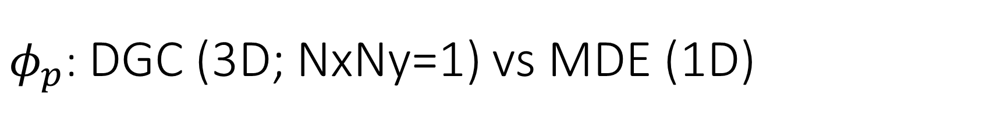
$φ_{p}$: DGC (3D; NxNy=1) vs MDE (1D)
Ns/sigs: dz = 0.10, Ngz_2 = 4$σ$; Chis/bs: dz = 0.25, Ngz_2 = 3.5$σ$

Slide 40


Numericals
Ys
Possibly do Ngz for multiple dzs

Slide 41








3D
Lxy = 1
Lxy = 10
Lxy = 5
Lxy = 15
y-z heatmaps for $φ_{p}$ at constant x

Slide 42





z-FFT vs z-FD (MDE) – REDFT01 xy(z)
Lx = 5, Ly = 5, Lz = 50. s = 0.02. x = 0.75. a = 0.00, N = 50
3D vs 1D (dashed): dz = 0.5, ds = 0.20; dz_1D = 0.113, ds_1D = 0.083
FFT (xyz)
FFT (yz vs pha)
FD (xyz)
FD (yz vs pha)
Diff btw 1D/3D should just be dz, ds, etc.

Slide 43
Specifying Grafted Points

Slide 44
Strategy
2D binary array for surface sites of homogeneously grafted polymer given grafting density, simulation box size, and discretization (and assuming dx = dy)
Fullspace must be periodic on x0 = xL, y0 = yL
Halfspace must be even on xL/2 and yL/2 (overlap of boundary following REDFT00) and periodic on x0 = xL, y0 = yL.
Homogeneous spacing as determined by regular hexagon, where grafting point at centroid of hexagon
In case there are edge effects, try shifting the centroids away from the boundaries of the xy-plane (only did for fullspace)
Make sure no edge effects by comparing results of full FFT with cos FFT

Slide 45
Test conditions
Sigma = 0.05 c/nm2
Lx = 15 nm
Ly = 15 nm
dx = 0.4 nm
Cast in terms of dx (for rounding and PBC for grafting points):
Sigma = 0.0668 c/nm2
Lx = 14.80 nm
Ly = 11.20 nm
(Sigma error decrease with dx)

Slide 46

Padded PBC (Full FFT)
Hexagons drawn for illustration of hexagon approach

Slide 47

Unpadded PBC (Full/Cos FFT)

Slide 48






Other conditions (full and half results overlapped to show match)
s = 0.0241 (20.28%; dx=0.4), Lx, Ly = 12.40, 20.80
s = 0.0208 (4.08%; dx=0.1), Lx, Ly = 12.90, 22.30
s = 0.1332 (11%; dx=0.1), Lx, Ly = 20.50, 20.40

Slide 49


